Slide 1
JQUERRY
BY TELYACHY VADYM

Slide 2
What is Жиквері? jQuery is an open source JavaScript library that simplifies the interactions between an HTML/CSS document, or more precisely the Document Object Model (DOM), and JavaScript. Elaborating the terms, jQuery simplifies HTML document traversing and manipulation, browser event handling, DOM animations, Ajax interactions, and cross-browser JavaScript development. There are several ways to start using jQuery on your web site. -Use the Google-hosted/ Microsoft-hosted content delivery network (CDN) to include a version of jQuery. -Download own version of jQuery from jQuery.com and host it on own server or local filesystem.

Slide 3
Why to use Жиквері? Some of the key points which supports the answer for why to use jQuery: It is incredibly popular, which is to say it has a large community of users and a healthy amount of contributors who participate as developers and evangelists. It normalizes the differences between web browsers so that you don’t have to. It is intentionally a lightweight footprint with a simple yet clever plugin architecture. Its repository of plugins is vast and has seen steady growth since jQuery’s release. Its API is fully documented, including inline code examples, which in the world of JavaScript libraries is a luxury. Heck, any documentation at all was a luxury for years. It is friendly, which is to say it provides helpful ways to avoid conflicts with other JavaScript libraries.

Slide 4
Basic Жиквері syntax $(selector).action() Were: A $ sign is to define/access jQuery A (selector) is to “query (or find)” HTML elements in html page A jQuery action() is the action to be performed on the selected element(s) Example: $(document).ready(function(){ $("button").click(function(){ $(".gfg").hide(); };) });

Slide 5
Document.ready
You might have noticed that all jQuery methods I my example, is inside a document ready event:
$(document).ready(function(){ // jQuery methods go here... });
This is to prevent any jQuery code from running before the document is finished loading (is ready).
It is good practice to wait for the document to be fully loaded and ready before working with it. This also allows you to have your JavaScript code before the body of your document, in the head section.
Here are some examples of actions that can fail if methods are run before the document is fully loaded:
Trying to hide an element that is not created yet
Trying to get the size of an image that is not loaded yet

Slide 6
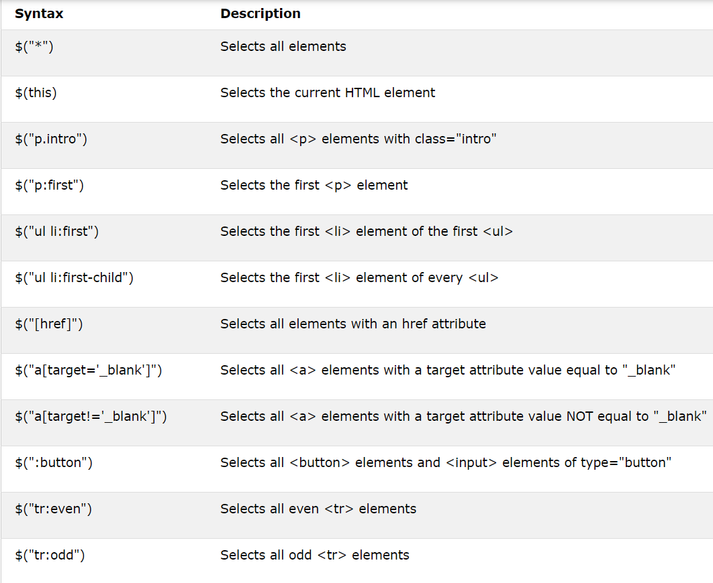
Selectors
$("p")
$("#test")
$(".test")
The element Selector
The jQuery element selector selects elements based on the element name.
The #id Selector
The jQuery #id selector uses the id attribute of an HTML tag to find the specific element.
The .class Selector
The jQuery .class selector finds elements with a specific class.

Slide 7
Events
$("p").click(function(){ $(this).hide(); });
$("p").dblclick(function(){ $(this).hide(); });
$("#p1").mouseenter(function(){ alert("You entered p1!"); });
$("#p1").mouseleave(function(){ alert("Bye! You now leave p1!"); });
$("#p1").mouseup(function(){ alert("Mouse up over p1!"); });
Click()
The function is executed when the user clicks on the HTML element.
Dblclick()
The function is executed when the user double-clicks on the HTML element:
mouseenter()
The function is executed when the mouse pointer enters the HTML element
mouseleave()
The function is executed when the mouse pointer leaves the HTML element
mousedown/mouseup()
The function is executed, when the left, middle or right mouse button is pressed/released, while the mouse is over the HTML element

Slide 8
More events
$("#p1").hover(function(){ alert("You entered p1!"); }, function(){ alert("Bye! You now leave p1!"); });
$("input").focus(function(){ $(this).css("background-color", "#cccccc"); });
$("input").blur(function(){ $(this).css("background-color", "#ffffff"); });
$("p").on({ mouseenter: function(){ $(this).css("background-color", "lightgray"); }, mouseleave: function(){ $(this).css("background-color", "lightblue"); },});
Hover()
The first function is executed when the mouse enters the HTML element, and the second function is executed when the mouse leaves the HTML element
Focus()
The function is executed when the form field gets focusmouseenter()
The function is executed when the mouse pointer enters the HTML element
Blur()
The function is executed when the form field loses focus
On()
The on() method attaches one or more event handlers for the selected elements

Slide 9
Effects
$("#hide").click(function(){ $("p").hide(); }); $("#show").click(function(){ $("p").show(); });
$("button").click(function(){ $("#div1").fadeToggle(); $("#div2").fadeToggle("slow"); $("#div3").fadeToggle(3000); });
$("#flip").click(function(){ $("#panel").slideToggle(); });
$("#stop").click(function(){ $("#panel").stop(); });
$("button").click(function(){ $("div").animate({ left: '250px', height: '+=150px', width: '+=150px' });});
Hide/show()
You can hide and show HTML elements with the hide() and show() methods
Fade()
You can fade elements in and out of visibility.
fadeIn,fadeOut, fadeToggle,fadeTo
slide()
You can create a sliding effect on elements
slideDown,slideUp,slideToggle
stop()
You can stop animation
animate()
The jQuery animate() method is used to create custom animations.

Slide 10
Callback
JavaScript statements are executed line by line. However, with effects, the next line of code can be run even though the effect is not finished. This can create errors.
To prevent this, you can create a callback function.
A callback function is executed after the current effect is finished.
Typical syntax:
$(selector).hide(speed,callback)
Example:
$("button").click(function(){
$("p").hide("slow", function(){
alert("The paragraph is now hidden");
});
});

Slide 11
Chaining
With jQuery, you can chain together actions/methods.
Chaining allows us to run multiple jQuery methods (on the same element) within a single statement.
Example:
$("#p1").css("color", "red").slideUp(2000).slideDown(2000);

Slide 12
GET/SET
One very important part of jQuery is the possibility to manipulate the DOM.
jQuery comes with a bunch of DOM related methods that make it easy to access and manipulate elements and attributes.
GET/SET CONTENT
Text()
Sets or returns the text content of selected elements
Html()
Sets or returns the content of selected elements (including HTML markup)
Val()
Sets or returns the value of form fields
<p id="test">This is some <b>bold</b> text in a paragraph.</p>
$("#btn1").click(function(){ alert("Text: " + $("#test").text()); });
$("#btn2").click(function(){ alert("HTML: " + $("#test").html()); });
<p>Name: <input type="text" id="test" value=“Hello there"></p>
$("#btn1").click(function(){ alert("Value: " + $("#test").val()); });

Slide 13
Add elements
With jQuery, it is easy to add new elements/content.
ADD CONTENT
Append/prepend(“your text”)
jQuery methods inserts content AT THE END/BEGINNING of the selected HTML elements.
After/before(“your another text”)
The jQuery methods insert content AFTER/BEFORE the selected HTML elements.
REMOVE CONTENT
Remove()
The jQuery remove() method removes the selected element(s) and its child elements.
Empty()
The jQuery empty() method removes the child elements of the selected element(s).
$("p").prepend/append("Some appended text.");
$("img").after/before("Some text after");
$("#div1").remove();
$("#div1").empty();

Slide 14
Styles in jQuerry
$("button").click(function(){ $("h1, h2, p").add/removeClass("blue"); });
$("button").click(function(){ $("h1, h2, p").toggleClass("blue"); });
Info:
$("p").css("background-color");
Change:
$("p").css({"background-color": "yellow"});
jQuery has several methods for CSS manipulation
Add/removeClass()
Adding or removing class from element
ToggleClass()
This method toggles between adding/removing classes from the selected elements
Css()
The css() method sets or returns one or more style properties for the selected elements. Also you can change direct property with css() method

Slide 15
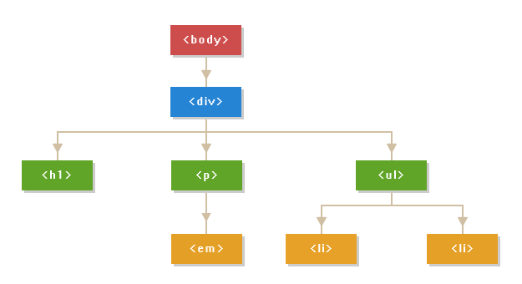
Traversing in jQuerry
jQuery traversing, which means "move through", are used to "find" (or select) HTML elements based on their relation to other elements. Start with one selection and move through that selection until you reach the elements you desire. jQuery provides a variety of methods that allow us to traverse the DOM.
THIS IS TRAVERSING TREE →

Slide 16
Traversion
PARENTS
Parent/parents(“element”)
This methods returns first/all ancestor elements of the selected element, all the way up to the document's root element
ParentUntil(“element”)
The parentsUntil() method returns all ancestor elements between two given arguments.
CHILDRENS
Children()
The children() method returns all direct children of the selected element. ONLY 1 LEVEL!
Find()
The find() method returns descendant elements of the selected element, all the way down to the last descendant.
$(document).ready(function(){ $("span").parent(); });
$(document).ready(function(){ $("span").parents("ul"); });
$(document).ready(function(){ $("span").parentsUntil("div"); });
$(document).ready(function(){ $("div").children("p.first"); });
$(document).ready(function(){ $("div").find("span"); });

Slide 17

AJAX
jQuery provides several methods for AJAX functionality.
With the jQuery AJAX methods, you can request text, HTML, XML, or JSON from a remote server using both HTTP Get and HTTP Post - And you can load the external data directly into the selected HTML elements of your web page!
Info: 99% of all jQuery installs after 2018 are used only for AJAX
Load()
Its used for loading data from external files/links
$("#div1").load("demo_test.txt #p1");

Slide 18
GET/POST
$("button").click(function(){ $.get("demo_test.asp", function(data, status){ alert("Data: " + data + "\nStatus: " + status); }); });
$("button").click(function(){ $.post("demo_test_post.asp", { name: “Obi One", status: “Dead" }, function(data, status){ alert("Data: " + data + "\nStatus: " + status); }); });
jQuery has several methods for CSS manipulation
Get(URL, callback)
The $.get() method requests data from the server with an HTTP GET request.
Post(URL,data,callback)
The $.post() method requests data from the server using an HTTP POST request.

Slide 19
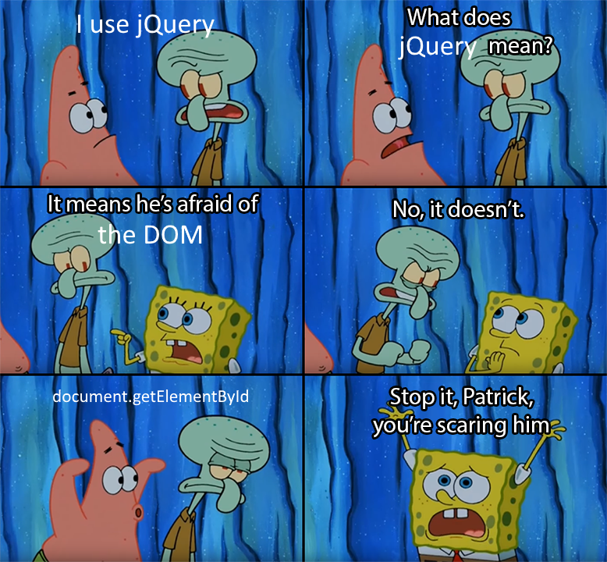
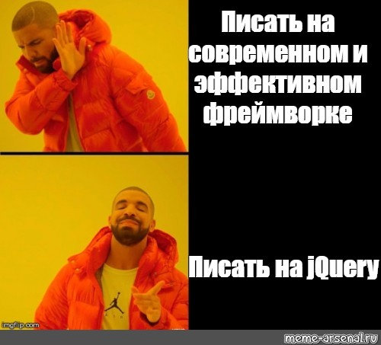
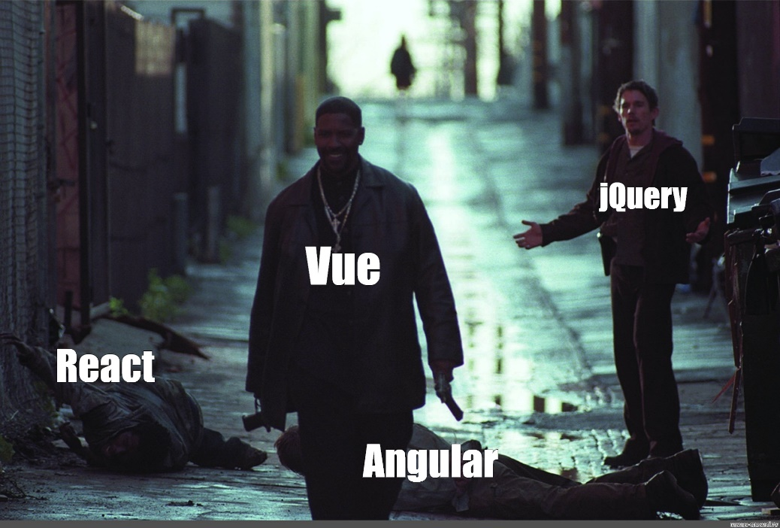
Ю
Р
А
<-
(наканецта)

